Slide 1
Supporting the transition to post primary school
Nicola Hart, Down Syndrome Ireland

Slide 2
Changes!
Bigger school
Lots of different classrooms
Students and teachers who don’t know your child
Regular movement breaks
Different teachers
Different opportunities

Slide 3
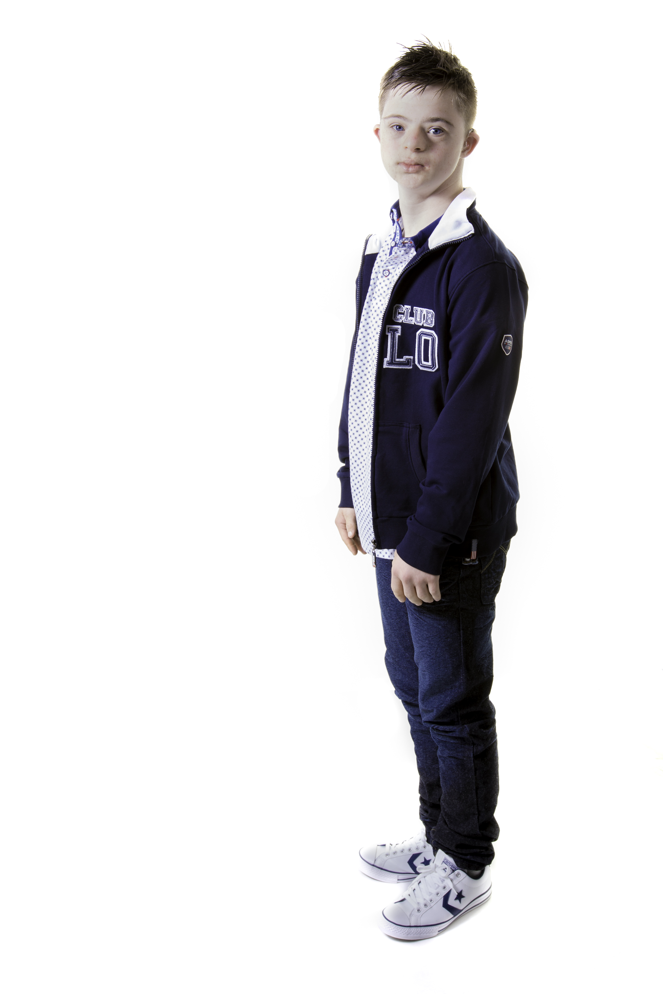
Changes!
New vocabulary
New routines
New expectations
New peers
New SNAs

Slide 4
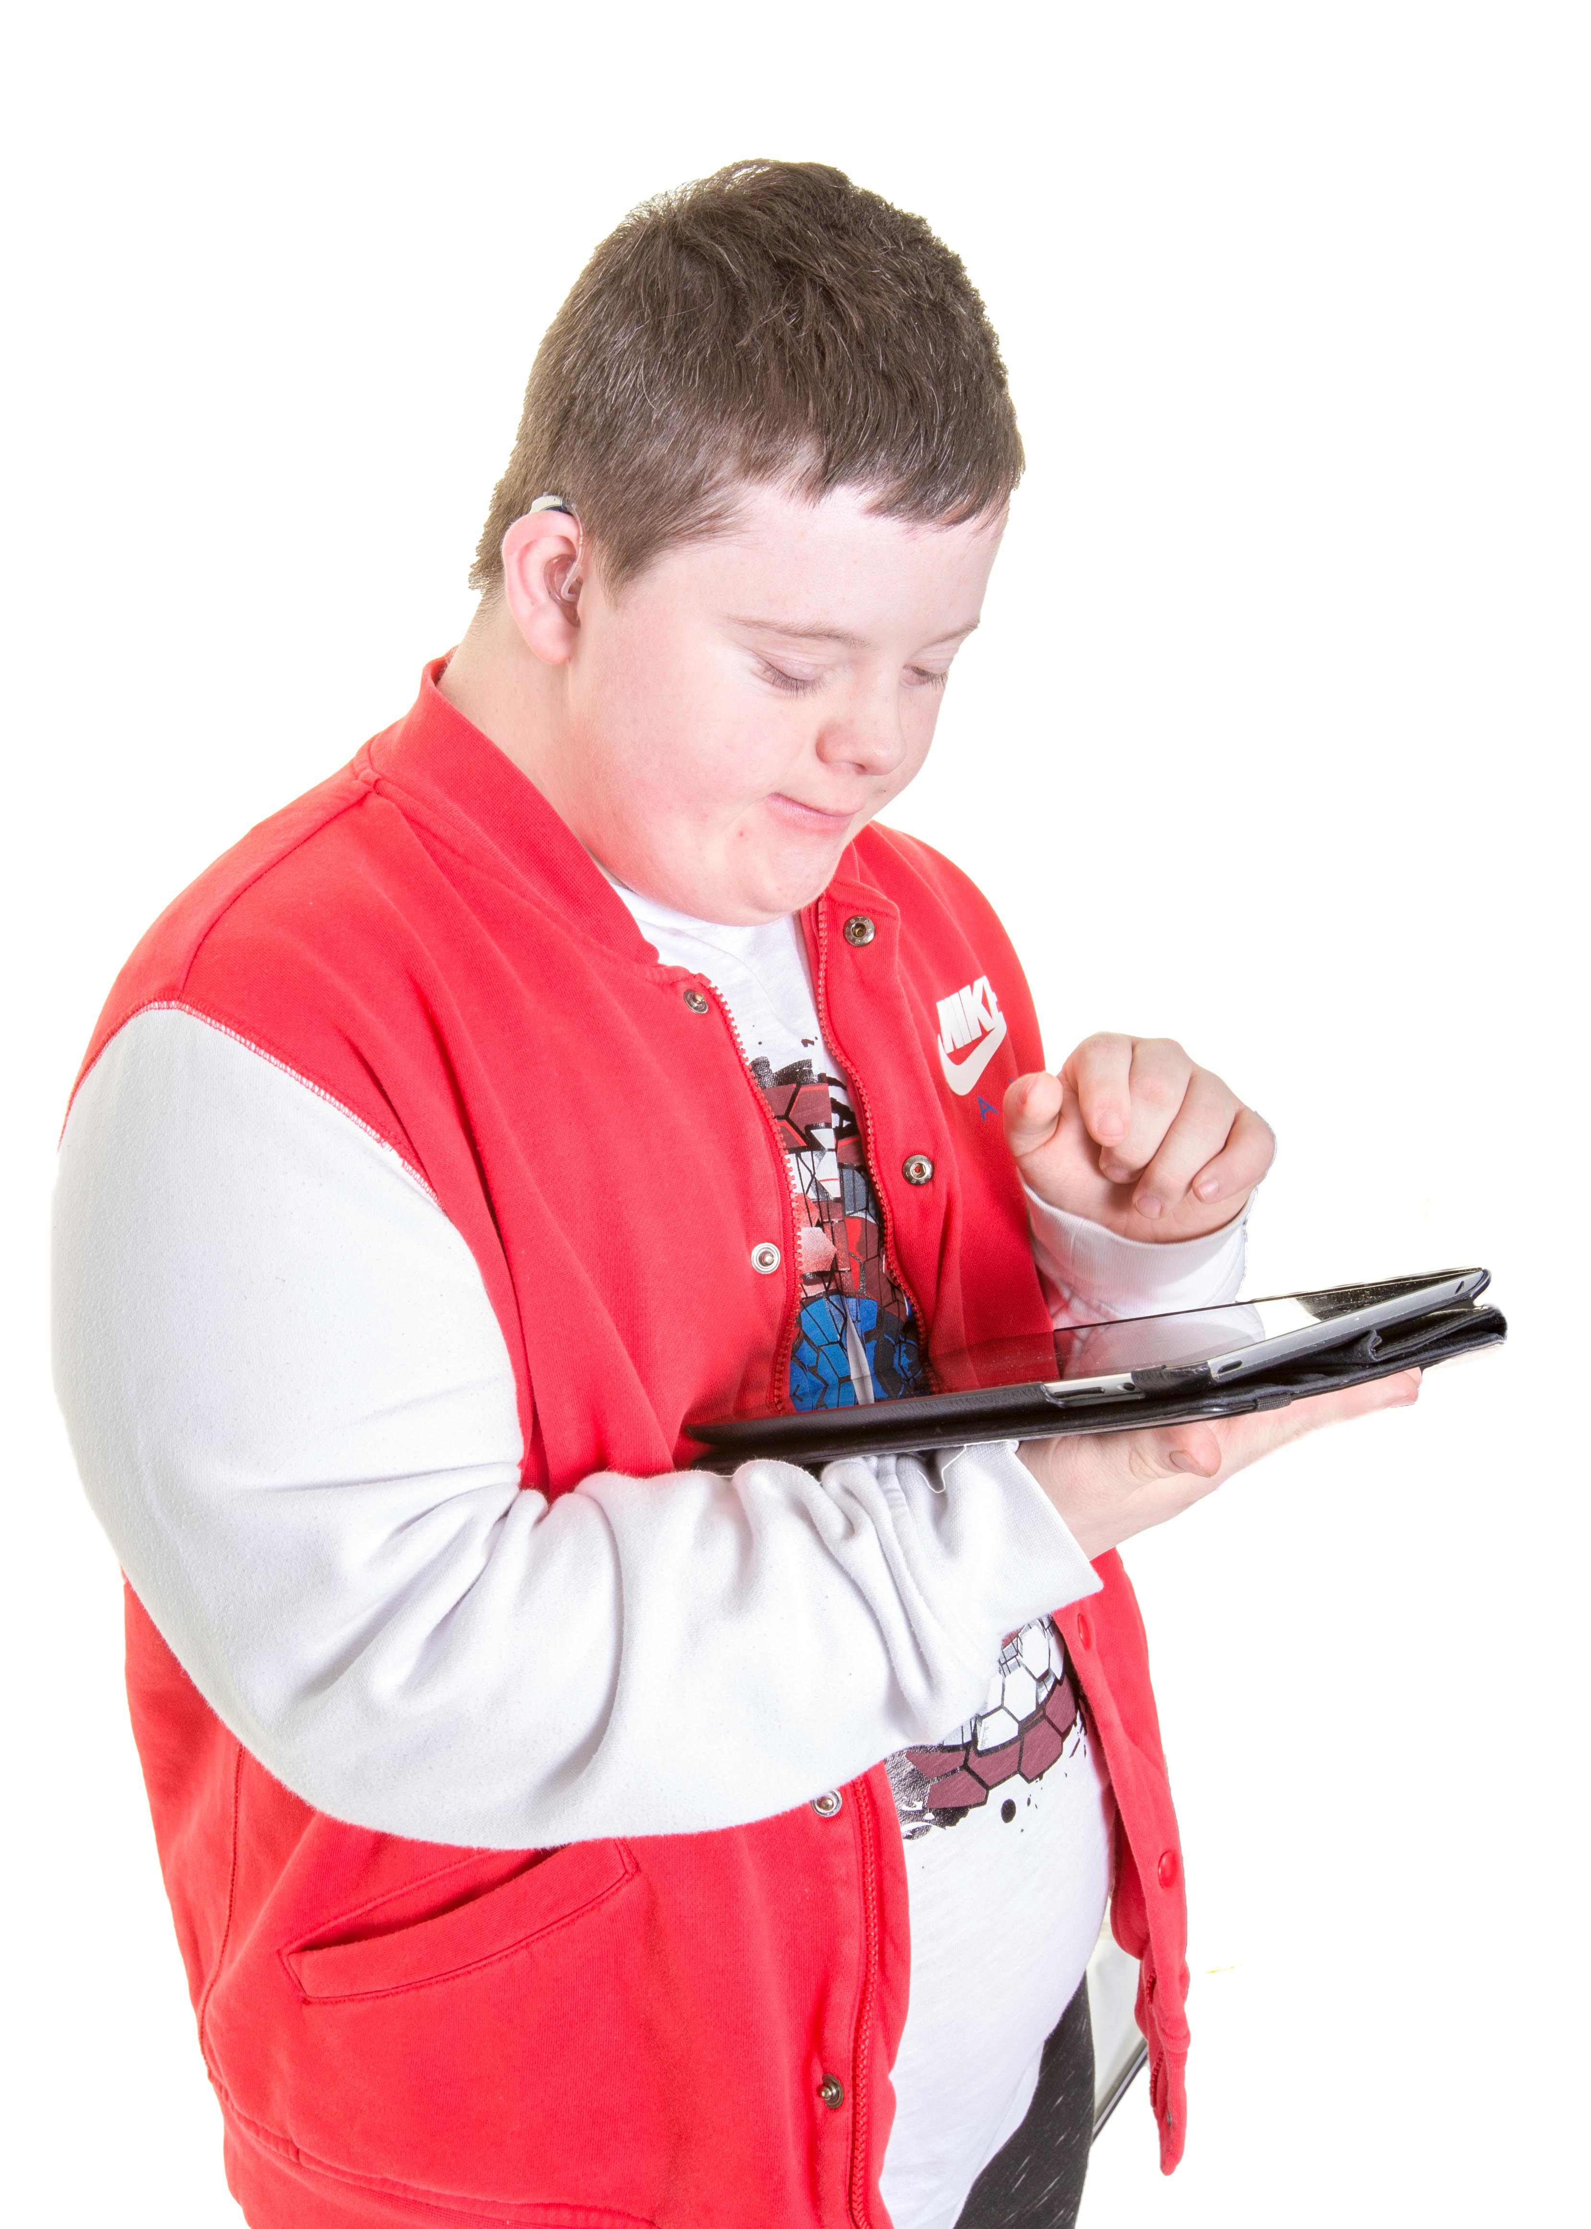
Key Issues
Speech and language disorder
Hearing loss
Auditory processing difficulties
Visual difficulties
Working memory difficulties

Slide 5
Speech and Language Disorder
All students with Down syndrome have speech, language and communication disorders over and above what would be expected for their general intellectual ability.
Having a language disorder is a significant additional disability which needs to be specifically addressed.

Slide 6
Auditory processing and working memory
Auditory processing and short term memory are usually poor
Long term memory and spatial memory are usually good
Visual supports, lists, written language, processing time, predictable routines, will all help

Slide 7
Hearing Loss
Around 80% of students with Down syndrome will experience at least some degree of hearing loss some of the time.
Bear this in mind when considering classroom position, background noise, etc.
Talk to the primary school and look for information about hearing and support from a visiting teacher.

Slide 8
Visual difficulties
Students with Down syndrome do not see as clearly as their peers.
Around 60% wear glasses, but these do not fully correct their vision.
Materials need to be differentiated for vision, as well as for content.

Slide 9
Suggestions to support vision
Move students desk closer to the whiteboard
Write larger on the board or change the colour of marker used – increase the contrast i.e. black on white / white on black
Reduce copying from the board by providing material at the desk
Ensure worksheets/books have larger print and increased contrast
Reduce visual distractions from worksheets.
Reduce the amount of information on a page/worksheet
Be aware that the student may not see coloured print in textbooks as easily as typical students
Ensure that colour coding involves bright colours
Make full use of IT
https://www.cardiff.ac.uk/downs-syndrome-vision-research-unit/get-advice/for-teachers

Slide 10
Inclusion
What does real inclusion look like?
Are there opportunities for all students to help and be helped?
Are there role models?
What is the balance between fear and inclusion? Is the student going to be ‘minded’ all the time?

Slide 11
Inclusion
Get a good handover from family and primary school
Discuss rights and responsibilities, risks and benefits explicitly
Many adults with Down syndrome are pretty independent, so don’t assume help is needed for everything
Take a problem solving approach ‘what do they need to learn in order to make this possible?’

Slide 12
Inclusion
Involve the student in all aspects of school life and school routines
Support social independence in school and the development of friend­ships with peers
Support the development of leisure skills and inclusion with peers in break and lunchtimes
Encourage, model and expect age-appropriate, socially acceptable behaviour at all times

Slide 13
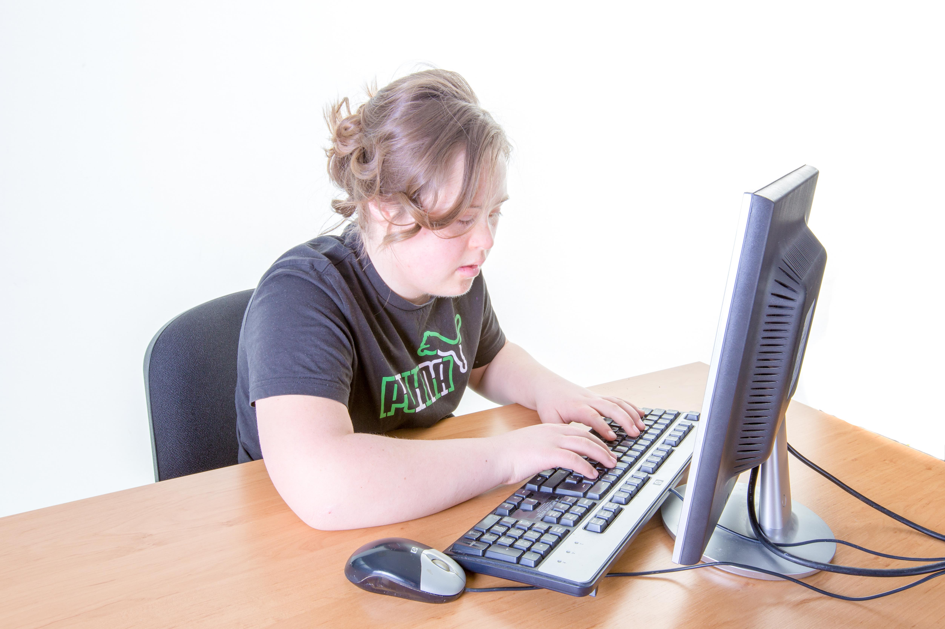
Make sure that everyone has high expectations.
Students with Down syndrome may not be competing in the points race, but many go on to further education and employment, and live full and active lives as valued members of their local community

Slide 14
Contact emails:
    Nicola@downsyndrome.ie
    Fidelma@downsyndrome.ie

