Slide 1
Managing the Transition from Primary to Post Primary School
Welcome

Slide 2
SNA Support

Slide 3
Role of the SNA
The role of the SNA to support the care needs of students in mainstream classes, as set out in Circular 0030/2014 remains unchanged.

Slide 4
What is an SNA?
The SNA is an assistant who helps the child with his / her day to day needs in school under the guidance and direction of the teacher.
The SNA is not a teacher
The teachers have primary responsibility for teaching and learning and for the social and emotional development and progress of the pupil.

Slide 5
Care Needs Consistent with the DES Circular 0030/2014
Assistance with feeding: where a child requires adult assistance
Administration of medicine: where a child requires adult assistance to administer medicine
Assistance with toileting and general hygiene: (including catheterisation) where a child with special needs cannot independently self-toilet, and until such time as they are able to do so

Slide 6
Care Needs Consistent with the DES Circular 0030/2014
Assistance with mobility and orientation: on an ongoing basis including assisting a child or children to access the school, the classroom, with accessing school transport Every effort must be made by the school to provide opportunities for independence e.g. the removal of hazards
Assisting teachers to provide supervision in the class, playground and school grounds: at recreation, assembly, and dispersal times including assistance with arriving and departing from school

Slide 7
Care Needs Consistent with the DES Circular 0030/2014
Non-nursing care needs associated with specific medical conditions: such as frequent epileptic seizures or for pupils who have fragile health.
Care needs requiring frequent interventions including withdrawal of a pupil from a classroom when essential: This may be for safety or personal care reasons, or where a child may be required to leave the class for medical reasons or due to distress on a frequent basis.

Slide 8
Care Needs Consistent with the DES Circular 0030/2014
Assistance with moving and lifting of children, operation of hoists and equipment.
Assistance with severe communication difficulties including enabling curriculum access for pupils with physical disabilities or sensory needs and those with significant, and identified social and emotional difficulties. Under the direction of the teacher, this might include assistance with assistive technology equipment, typing or handwriting, supporting transition, assisting with supervision at recreation, dispersal times etc.

Slide 9
Access to SNA
The majority of children who have care needs, however, require attention and assistance at certain times of the school day and require intermittent intervention at particular points.

Slide 10
Access to SNA
Students who have care needs requirements are therefore granted access to SNA support, whereby an allocation of SNA support is allocated to a school, is reflective of the assessed individual needs of a group of identified children.
Those SNAs will then be in a position to cater for the care needs of those designated pupils, as the need arises, and as they require assistance, with the level of support being provided reflecting actual need at any given time.

Slide 11
SNA Duties
SNA duties are assigned at the discretion of the Principal, or another person acting on behalf of the Principal, and/or the Board of Management of a school
The work of SNAs should, at the principal or teacher’s direction, be focused on supporting the particular care needs of the student with special educational needs and should be monitored on an ongoing basis and modified accordingly.

Slide 12
Parents
The role and duties of SNAs should be communicated to parents by school authorities, when discussing the issue of SNA support for their child.

Slide 13
Circulars
Circulars can be accessed
www.education.ie

Slide 14
Transition to Post Primary School
  Goals for Children with SEN at Post Primary School
  Preparing the Child – what can be done at Primary School
  Junior Cycle
  Level 2 Learning Programmes (L2LP)

Slide 15
Transition to Post Primary School
Careful planning and preparation helps students with special educational needs to transition with greater ease and success.
Parents, primary and post-primary schools all have an important part to play in the transition from primary school.
For students with complex special educational needs, planning for post-primary should start two to three years in advance of the transition – in 4th or 5th class of primary school.

Slide 16
Transition to Post Primary School
A transition plan will be needed to assist with the child’s transfer to post-primary school.
Parents & children should be involved in developing this plan.
Other people may be involved, as necessary, including relevant teachers from the primary and post-primary school, NEPS psychologist, health professionals involved with the child and/or the local SENO.

Slide 17
Transition to Post Primary School
Most post-primary schools will have links with their feeder primary schools. This allows for an easier transfer of information.
Usually, there is contact between the 6th class teacher/resource teacher and the receiving post-primary school which helps to overcome any disconnect between what was taught in primary and the starting point in certain subjects.

Slide 18
Important Note
Additional supports that your child receives in primary school do not automatically transfer to post-primary school.
This is because children’s needs change over time and they may require a greater or lesser amount of support to manage in a post-primary school.

Slide 19
Goals for Children with SEN at Post Primary School
Goals & Expectations

Slide 20
Goals & Expectations
to involve the teenager in all aspects of school life and school routines
to support social independence in school and the development of friend­ships with peers
to support the development of leisure skills and inclusion with peers in break and lunchtimes
to encourage, model and expect age-appropriate, socially acceptable behaviour at all times
to be familiar with the research findings which demonstrate a specific cognitive profile associated with Down Syndrome and to adapt teaching methods appropriately

Slide 21
Goals & Expectations
to provide access to all areas of the school curriculum at a level appropri­ate for the individual teenager
to recognise the importance of teaching reading and writing daily
to develop speech, language and working memory skills as well as literacy skills
to facilitate independent learning and the ability to work and to learn as part of a group
to make full use of computer aided learning, with appropriate software for individual and group work

Slide 22
Preparing the Child
Things that can be done in Primary School

Slide 23
Things that can be done in Primary School
Teach the students how to read school timetables and get samples from post-primary schools – this can be done within whole class maths lessons
Give the class different due dates for certain pieces of homework in order to prepare them for a more complex timetable
Consider colour coding copies and books.
Teach key words for specific subjects such as Home Economics, This can be done within the oral language strand of the English curriculum

Slide 24
Things that can be done in Primary School
Integrate transition activities into the SPHE programme. For example, teach students about post-primary school, dealing with change, etc
Attend open evenings in the post-primary school. This is a good opportunity to take photographs of rooms, etc.
Identify key personnel in the post-primary school and explain their roles to the student: e.g. class tutor, year head, chaplain, guidance counsellor, etc.
Model and practice recording homework in a journal at the end of lessons as opposed to the end of the school day

Slide 25
Things that can be done in Primary School
Encourage parents to inform the post-primary school as soon as possible in relation to their child’s SEN, as resource hours and assistive technology will need to be reapplied for by the receiving school
Be prepared for the post-primary school to make enquiries once the student has enrolled.
Have a ‘Leaving Ceremony’ on the last day in sixth class – this is a clear signal to the students that they are moving on

Slide 26
Junior Cycle
Pathway through Junior Cycle

Slide 27
Pathway through Junior Cycle
When children move into 2nd level it is best practice that they are exposed to all subjects offered to 1st years in their school.
It is preferable that all children have this option.
Most make choices and reduce their subject numbers over the course of 1st year.

Slide 28
Pathway through Junior Cycle
For children with Down syndrome, this subject reduction usually starts around Halloween in 1st year with further reductions at Christmas time (maybe languages, maybe Science/Woodwork or some other subjects).
It all depends on the child’s interests and aptitudes.

Slide 29
Pathway through Junior Cycle
At the beginning of 2nd year, subjects may be further reduced
( maybe to 5/6).
Most commonly the subjects chosen at this point are
  English (very important to maintain literacy levels),
  Home Economics,
  Civic, Social and Personal Education (CSPE),
  Art, History/Geography
  Science

Slide 30
Pathway through Junior Cycle
Samples of Differentiation for these subjects are included in the Differentiation project on the DSI website.
For best results and to maintain interaction with peers and classmates, the student would continue to attend all mainstream classes in the chosen subjects

Slide 31
Pathway through Junior Cycle
It is not necessary to identify exam subjects until later.
Students can choose to take any number to Junior Certificate Exam level.
Some students decide to take 5 or more subjects for examination.
Other students may opt to do I or two subjects in one exam year and to do another subject in a different year.

Slide 32
Pathway through Junior Cycle
Given the reduced number of subjects being studied means the student will have free periods in the school day
  Ideally this will be the time when resource support is offered.
  This support can be in a one to one setting or in a small group.
  The teacher best placed to offer subject support is the child’s subject teacher.
  This could happen with any subject and many benefits accrue.
  The teacher really knows and understands the student’s ability level and is able to differentiate accordingly.

Slide 33
Pathway through Junior Cycle
Repeating a class is another positive way of learning for this group of students.
  Many schools will have two Home Ec. groups for 1st years each week.
ICT skills need constant work, as do Typing skills.
Involvement in games, PE classes, music groups, library work are all possibilities depending on interest and aptitude.

Slide 34
Pathway through Junior Cycle
Good planning, good timetabling and commitment from Principals and staff allow this system to happen.

Slide 35
Junior Cycle Option
  Level 2 Learning Programmes (L2LP)

Slide 36
L2LP
  Most post-primary schools now offer the option of the L2LP programme at junior cycle level
  Level 2 Learning Programmes (L2LPs) for students with particular special educational needs are designed to suit both special school and mainstream settings.
  L2LPs will build on prior learning and are designed primarily around 5 Priority Learning Units (PLUs) that focus on the social, personal and prevocational skills that prepare students for further study, for work and life

Slide 37
Who should Follow this Programme?
Students undertaking a L2LP are those with disabilities categorised as being in the lower mild to higher moderate range of general learning disabilities.
As far as possible the student will be included in mainstream classes.

Slide 38
L2LP Programme
The material contains:
    L2LP guidelines for teachers
    Case studies illustrating how they have been accommodated in different settings
    Short videos of practice
    Online tool for planning an L2LP
    www.ncca.ie

Slide 39

Useful Resources
Supporting Students with Down syndrome Transition from Primary to Post Primary School
&
Getting Ready for Post Primary School
My Workbook

Slide 40

Getting Ready for Post Primary School
My Workbook
Part One
  My primary school
  My new school
  My friends at school
  People who will help me at my new school
  School uniform
  Subjects
  Timetables

Slide 41
Getting Ready for Post Primary School
My Workbook
Part Two
Suitable for use in the first weeks of the new term
Times to remember
My timetable
My teachers & subjects
What do I need?
My thinking time
Pictures of my teachers
Pictures of other people in my school
Getting organised
What to do if…….

Slide 42
Further Information
There are a number of online presentations and a resources list you can access at the following link:
https://downsyndrome.ie/online-education-seminars

Slide 43
Further Information
There are other resources that would be useful in the ‘education professional’ section of the website
https://downsyndrome.ie/support-detail/education-professionals/

Slide 44
Other Useful Resources
Supporting Children with Down syndrome in Special School
Supporting Children with Down syndrome in Primary School
Supporting Students with Down syndrome in Post Primary School

Slide 45
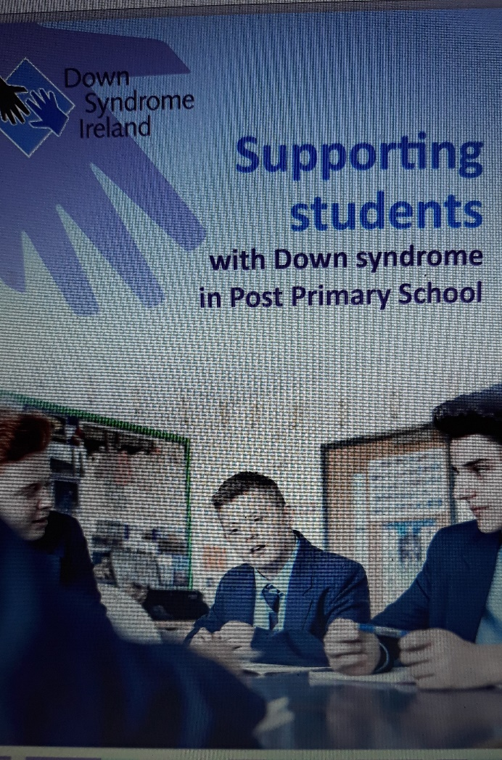


Useful Resources

Slide 46
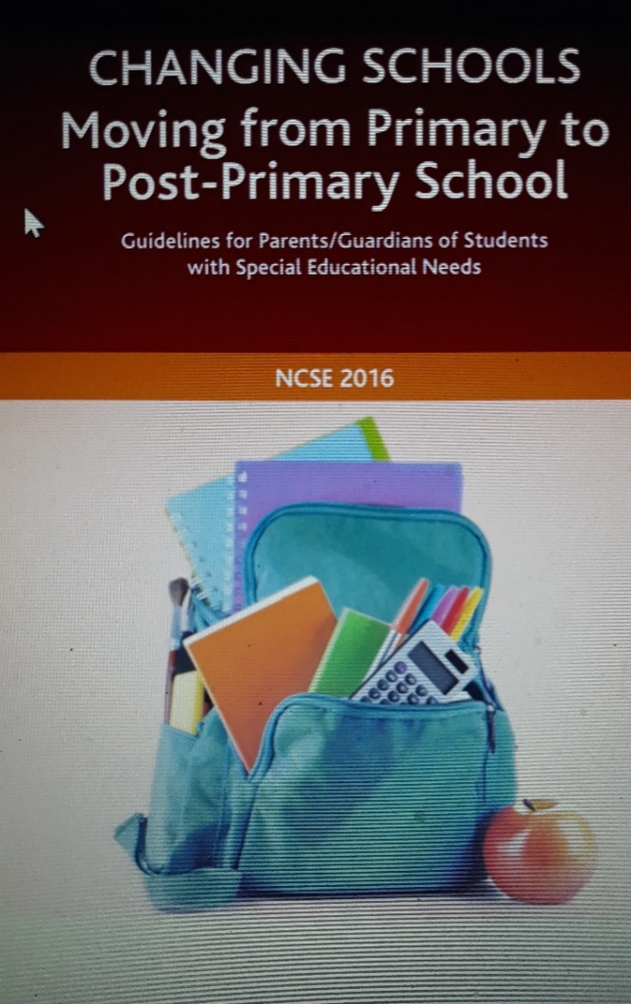
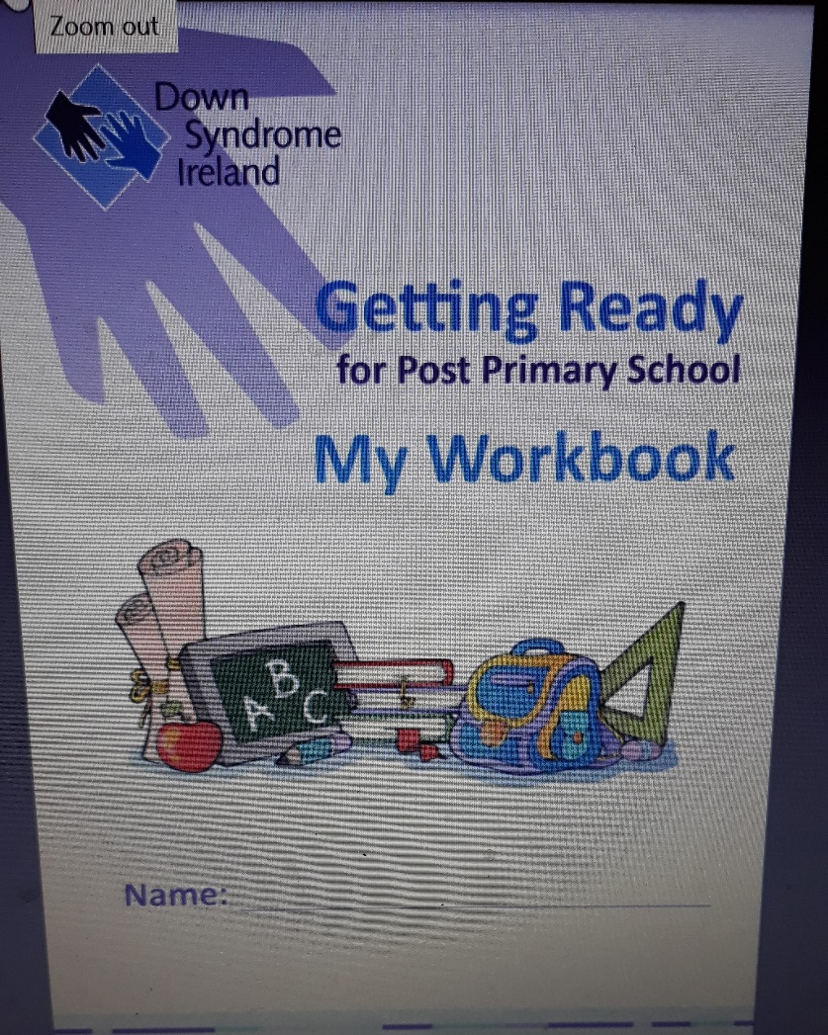
Useful Resources

Slide 47
Acknowledgement
Effective Education for Children with Down Syndrome in School
Professor Sue Buckley OBE
Down Syndrome Education International
Discovering Potential Transforming Lives

Slide 48
Contact Details
fidelma@downsyndrome.ie
nicola@downsyndrome.ie
www.downsyndrome.ie

